Slide 1
Module 3
3.2.Various feature selection Measures,C5.0 Decision tree Algorithm, Strengths & Weaknesses & Problem

Slide 2
The C5.0 decision tree algorithm
Some well-known decision tree algorithms
ID3 (Iterative Dichotomiser 3) developed by Ross Quinlan
C4.5 developed by Ross Quinlan
C5.0 developed by Ross Quinlan
CART (Classification And Regression Trees)
There are numerous implementations of decision trees, but one of the most well- known is the C5.0 algorithm. This algorithm was developed by computer scientist J. Ross Quinlan as an improved version of his prior algorithm, C4.5, which itself is an improvement over his ID3 (Iterative Dichotomiser 3) algorithm.

Slide 3
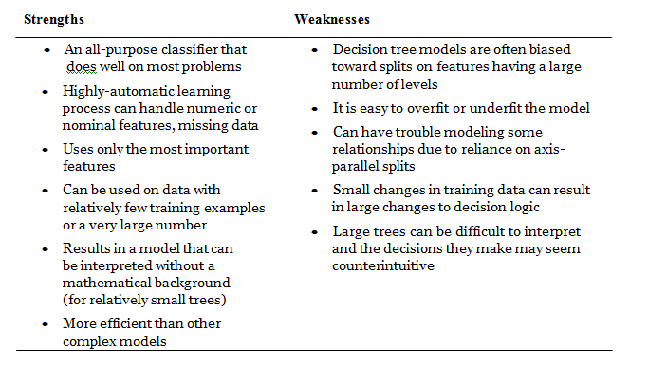
Strength & Weaknesses of C5.0

Slide 4
Choosing the best split
The first challenge that a decision tree will face is to identify which feature to split upon.
If the segments of data contain only a single class, they are considered pure. The degree to which a subset of examples contains only a single class is known as purity, and any subset composed of only a single class is called a pure class There are many different measurements of purity for identifying splitting criteria.
C5.0 uses entropy for measuring purity. Entropy is the “measure of the disorder of a system”. entropy³ is a measure of “impurity” in a dataset. The entropy of a sample of data indicates how mixed the class values are; the minimum value of 0 indicates that the sample is completely homogenous, while 1 indicates the maximum amount of disorder.

Slide 5

. The definition of entropy is specified by:
In the entropy formula, for a given segment of data (S), the term c refers to the number of different class levels, and pi refers to the proportion of values falling into class level i. For example, suppose we have a partition of data with two classes: red (60 percent), and white (40 percent). We can calculate the entropy as:
-0.60 * log2(0.60) - 0.40 * log2(0.40) [1] 0.9709506

Slide 6
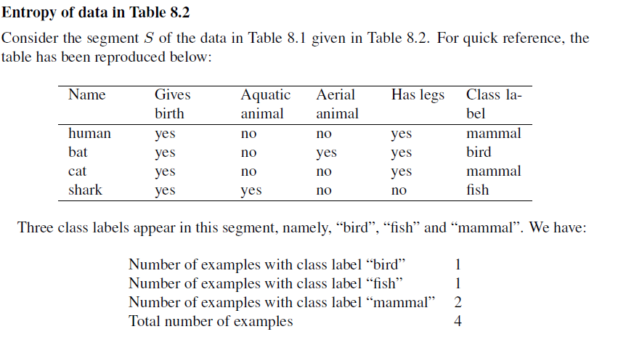
Entropy Calculation

Slide 7
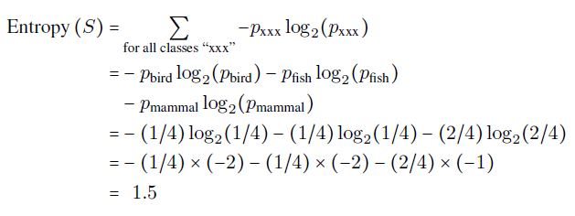

Slide 8
Feature selection measures
  Information gain(ID3)
  Gain ratio(C4.5 & C5.0)
  Gini indices(Gini Index- CART )

Slide 9
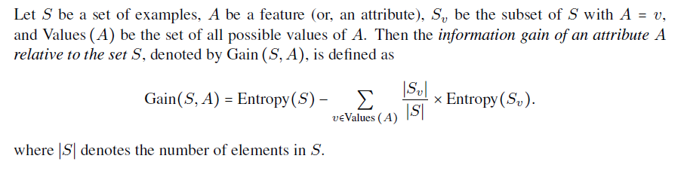
  Information gain(ID3)

Slide 10
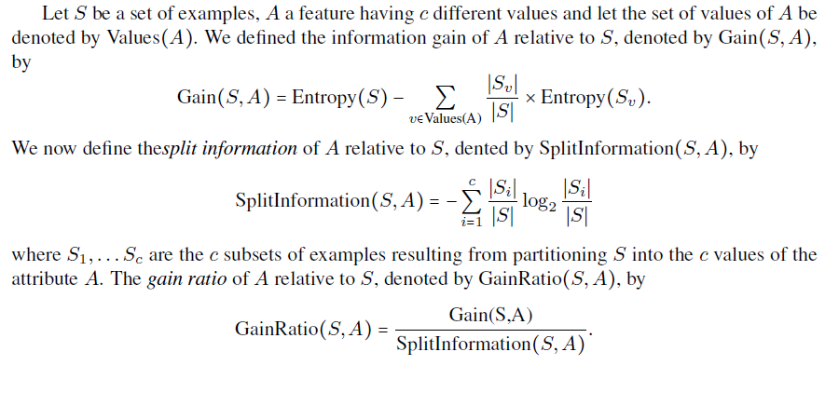
  Gain ratio(C4.5 & C5.0)

Slide 11
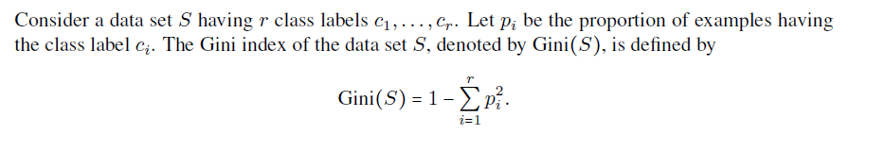
  Gini indices(Gini Index- CART )

Slide 12

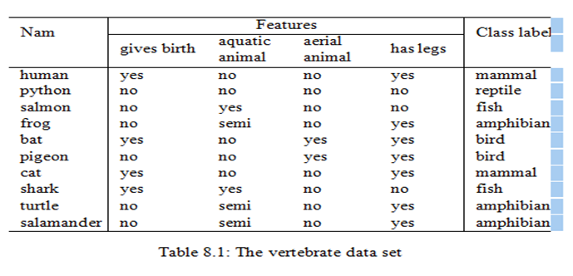
Problem(Gain Ratio)

Slide 13
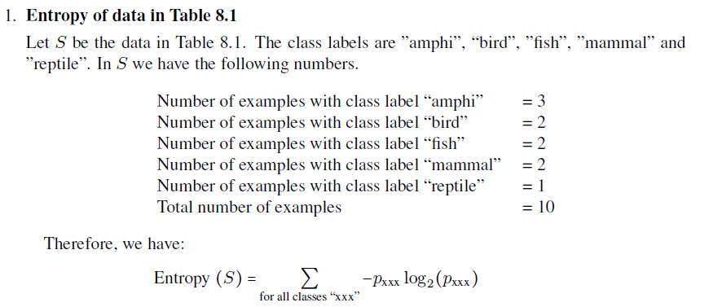
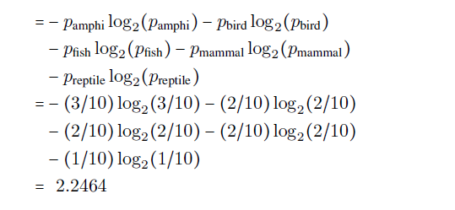

Slide 14
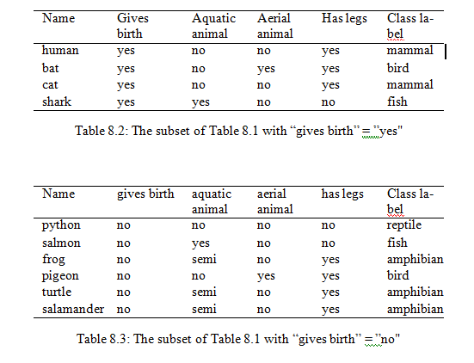

Slide 15
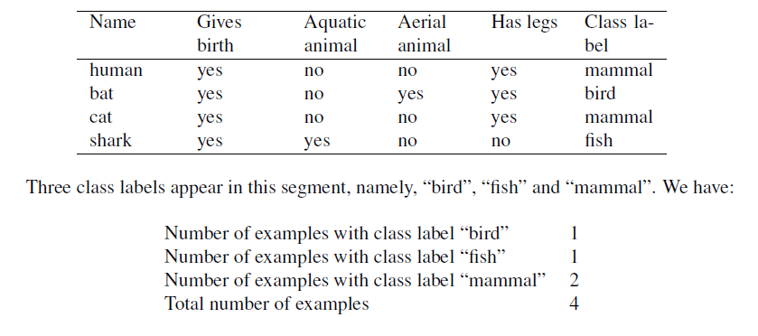
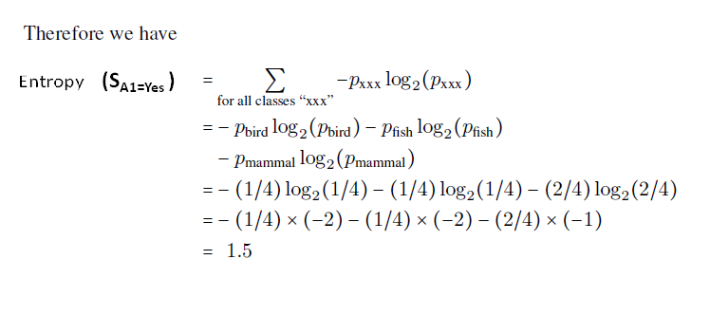
Calculation of entropy for the feature givesbirth =yes (S_{A1=Yes} )

Slide 16
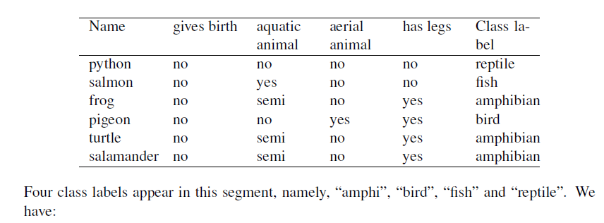
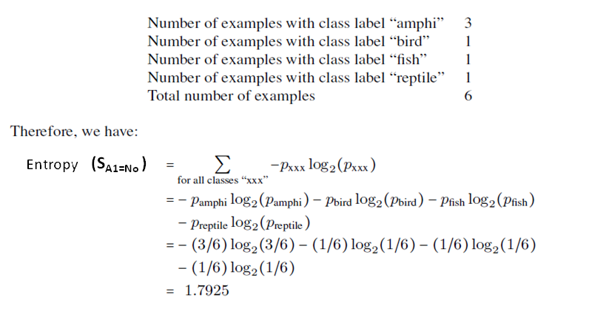
Calculation of entropy for the feature givesbirth = No (S_{A1=No} )

Slide 17
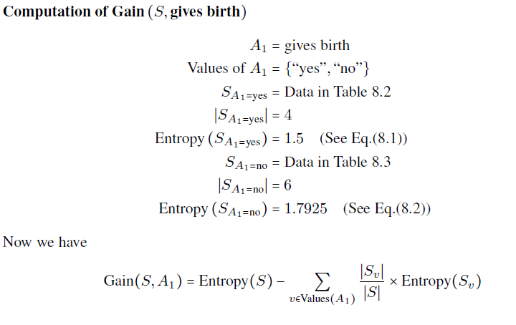
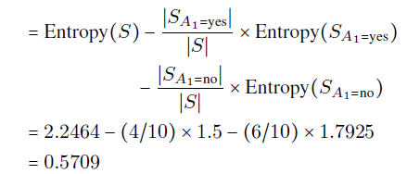

Slide 18
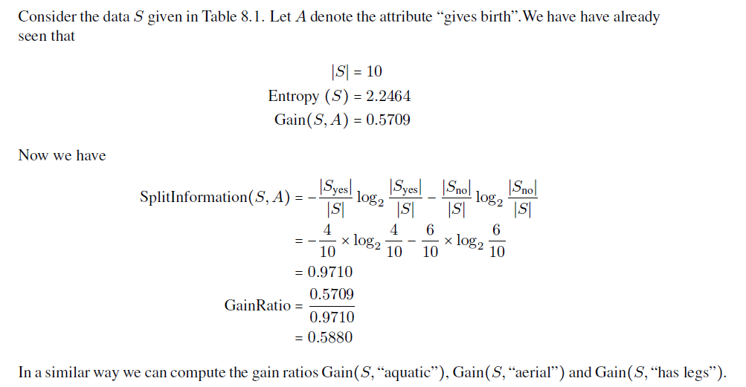

Slide 19
Pruning the decision tree
A decision tree can continue to grow indefinitely, choosing splitting features and dividing into smaller and smaller partitions until each example is perfectly classified or the algorithm runs out of features to split on.
However, if the tree grows overly large, many of the decisions it makes will be overly specific and the model will have been overfitted to the training data.
The process of pruning a decision tree involves reducing its size such that it generalizes better to unseen data

Slide 20
One solution to this problem is to stop the tree from growing once it reaches a certain number of decisions or if the decision nodes contain only a small number of examples. This is called early stopping or pre-pruning the decision tree.
An alternative, called post-pruning involves growing a tree that is too large, then using pruning criteria based on the error rates at the nodes to reduce the size of the tree to a more appropriate level.
This is often a more effective approach than pre-pruning because it is quite difficult to determine the optimal depth of a decision tree without growing it first.

